Slide 1
Anne Juuko
Chief Executive,
Stanbic Bank
Key Drivers for Business Resilience in a Post-Covid World

Slide 2

Content
The Economy is Fully Open
Stanbic’s Drivers to Build Resilience
Opportunities in the Post-Covid Era

Slide 3



The ECONOMY IS GOING
Key Highlights
Full reopening of the economy is accelerating activity in Households, Manufacturing, Construction, Trade, Agriculture and Transport.
Oil & Gas FID initiated in Q1 2022.
Long-awaited Middle-Income status (GDP per capita of $1,036) expected by 2023 – expected to boost consumption levels.

Slide 4
Macro policy remains supportive of ECONOMIC growth
EXCHANGE RATE AND INFLATION | INTEREST RATES
Inflation starting to rise after the re-opening of the economy, coupled with effects of increased fuel prices, which form 25% of our imports | The Central Bank maintained an accommodative monetary policy stance, holding the CBR at 6.5%. Interest rates were largely flat for the second half of the year in line with CBR

Slide 5
Businesses are increasingly switching on their lights
Purchasing Managers Index (PMI): This has started to pick up and reached 55.7 in Feb’22 driven by; Further growth of output & new orders Employment up for the 3rd time in the past 4 months Further increase in input costs Private Sector Credit growth: Slowed in December/Jan due to Omicron, but largely on an upward trend

Slide 6
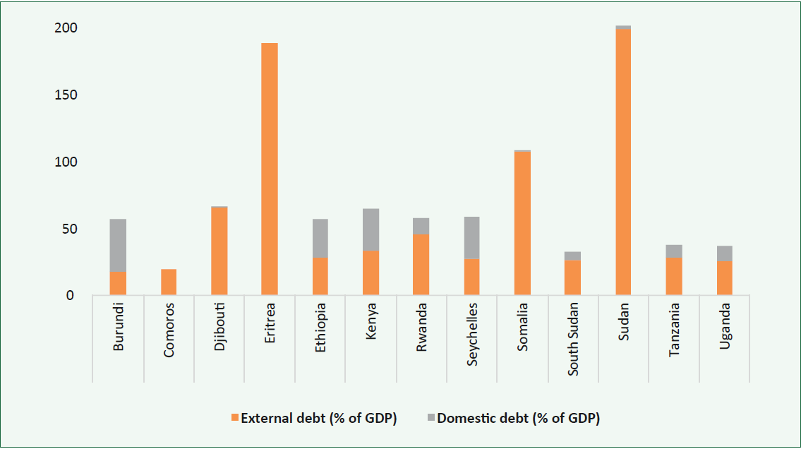
HOWEVER, THERE ARE SOME RISKS TO GDP GROWTH
.
Imported Inflation (Oil, wheat etc.)
Regional Geopolitical tensions
.
Spillover from International Conflict
.
Global Trade slump due to protectionist policies
.
Public Debt
Public debt stands at approx. 50% of GDP.
Low risk of debt distress, however debt servicing constitutes about 30% of tax revenue. (~Ugx 20 trn)
External debt ($12.8bn) makes up over 60% of total Gov’t debt.

Slide 7




COUNTRY THEMES PREVAILING POST-COVID
Do your products cut across the different eco-systems ?
Uganda is Young
Uganda is SME driven
Uganda is Connected
Uganda is Rising
Do your products support small businesses?
Are your products relevant to the Youth?
Are you ready for the Oil and Gas boom?

Slide 8
Content
The Economy is Fully Open
Stanbic’s Drivers to Build Resilience
Opportunities in the Post-Covid Era

Slide 9



HOW THE LAST TWO YEARS HAVE CHANGED THE WAY WE WORK
 | Collaboration not Hierarchy |  | Transparency not Need to know
 | Mission not Structure |  | Trust not Control
 | Sustainability not Short-term gains |  | Components not Projects
 | Experiments not Directives |  | Continuous Release not Major Releases

Slide 10

HOW we are preparing for future shocks
ORGANISATIONAL SKILLS
Embracing the emerging opportunities in the Digital economy
TOP 10 IN 2021
Complex problem solving Critical thinking Creativity People management Coordinating with others Emotional Intelligence Judgement and decision making Service orientation
Repurposing of staff
Structural adjustments
Partnering human & technology
Continuous learning
Fostering Innovation
Stronger client focus
Implementing disruptive technology
TECHNOLOGY SPECIFIC SKILLS
Cloud Data Security User experience / User Interface design Machine learning / AI Agile Developer
83% of Organisations believe they are are losing the war for talent (KPMG survey)

Slide 11
OUR CUSTOMER REMAINS THE TRUTH NORTH
UNDERSTANDING THE CUSTOMER NEED
04
Inefficiency / Low productivity in key and emerging sectors; Agriculture, Trade and Logistics
Youthful Population, Income inequality and Unemployment.
03
02
Financial Literacy and Inclusion Gap
Negatively Impacted Education and Health Sectors.
01

Slide 12
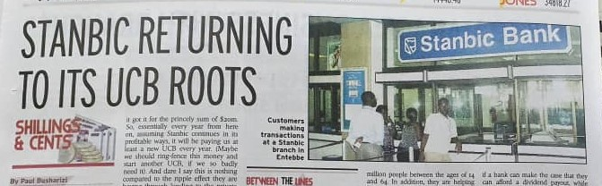
KEEPING OUR FOCUS ON THE CUSTOMER NEED
Still continuing to be an Exceptional Corporate bank
DE-RISKING AGRICULTURE
Capacity building through the Business Incubator
OneFarm Platform to digitize agriculture, increase efficiency and improve yields.
FINANCIAL INCLUSION
HEALTH SECTOR
Credit to over 150 Saccos (Impact on 220k beneficiaries); Agric. based SACCOs are accessing funds at 10% p.a
FlexiPay – Lowest cost financial inclusion tool, at the palm of your hand
EDUCATION SECTOR
Developed a value proposition that has benefited over 4000 medical practitioners and growing
Waived 2021 accumulated unpaid interest on loans
Laptops financing for students to promote E-learning
Unsecured lending of up to 500bn,

Slide 13
Content
The Economy is Fully Open
Stanbic’s Drivers to Build Resilience
Opportunities in the Post-Covid Era

Slide 14


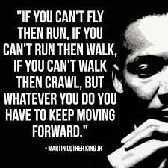

THE OPPORTUNITY AHEAD
Growth Opportunity
Insurance penetration less than 1%, which is below the Africa Avg of 2.78% and the Global Average of 7.23%
Search for Relevance
Adapt products / covers to local requirements and customer needs.
Inclusion
Enhanced distribution through partnerships, and mass education drives to change industry sentiments.
Skills and People
Future-proofing the industry through continuous learning and adopting best in class practices.

Slide 15
Thank you

